Slide 1
CAP-791
Unit - III

Slide 2
How User Authentication is Done
Although you probably already use a password to protect your Windows 10 account and files from unauthorized access, there are plenty of reasons you may also want to set a password to protect Word, Excel, or PowerPoint documents.
For example, you might have to share a document with sensitive information and want to make sure that only one person has access to it.

Slide 3
Continue..
Maybe you usually save documents to OneDrive or another cloud storage service, and you want to add an extra layer of protection, in case the account gets compromised.
Or perhaps you work in an environment where many people may have physical access to your computer, and you simply want to keep prying eyes out of certain data.

Slide 4
Continue..
Whatever the reason, Office 365 as well as Office 2019, Office 2016, and older versions include settings to quickly encrypt a document using a password.
Steps to protect an Office document using a password.
How to set a password for an Office document
How to remove a password from an Office document

Slide 5
How to set a password for an Office document
To add an encryption password to Microsoft Word, Excel, or PowerPoint, use these steps:
Open the Word (Excel or PowerPoint) document.
Click on File.
Click on Info.
On the right side, click the Protect document menu.
Note: In Excel, the option will appear as "Protect Workbook," and in PowerPoint, it'll be displayed as "Protect presentation."

Slide 6
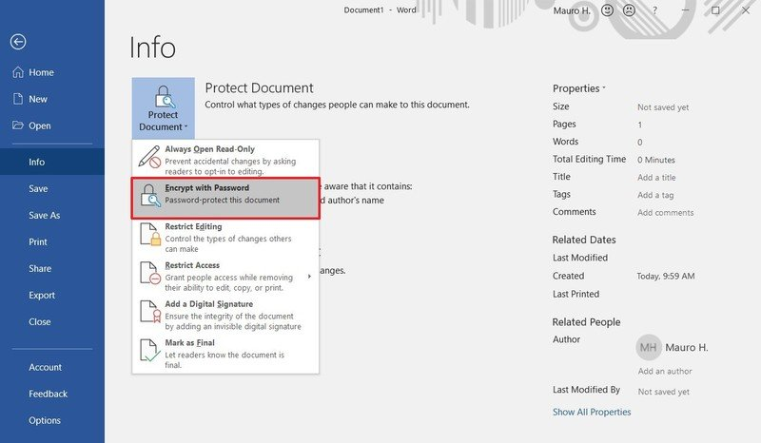
Select the Encrypt with Password option.

Slide 7
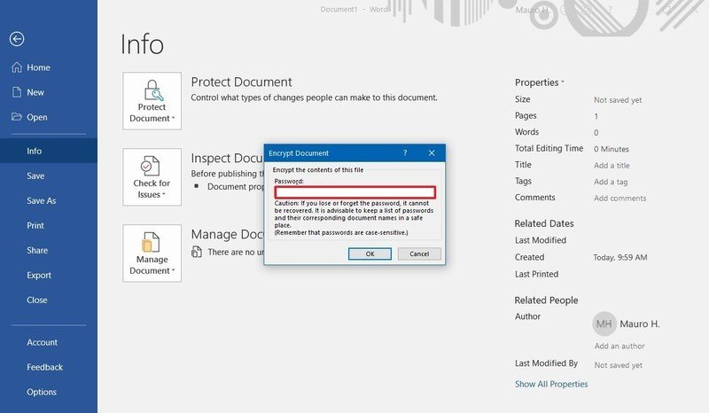
Type a password to protect the document.

Slide 8

Continue..
Click the OK button.
Retype the password.

Slide 9
Continue..
Click the OK button.
Once you complete these steps, every time you open the document, you'll be prompted to enter a password to decrypt its contents.
When setting up a password for an Excel, PowerPoint, or Word document, consider that without a password it'll be virtually impossible to open the document, so make sure to keep the password in a safe place.

Slide 10
How to remove a password from an Office document
To remove the password of an Office document (Word, Excel, or PowerPoint), use these steps:
Open the Word (Excel or PowerPoint) document.
Type the current password to access the file.

Slide 11
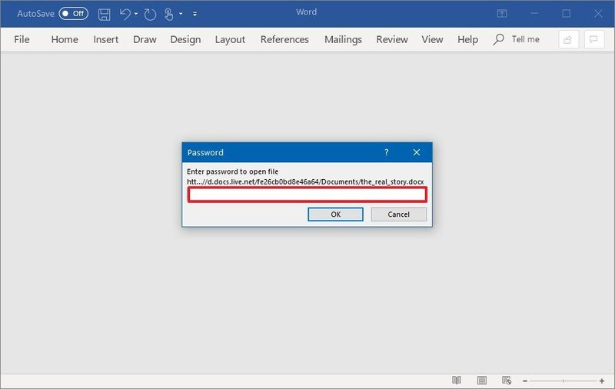
Continue..

Slide 12
Continue..
Click the OK button.
Click on File.
Click on Info.
On the right side, click the Protect document menu.
Select the Encrypt with Password option.

Slide 13
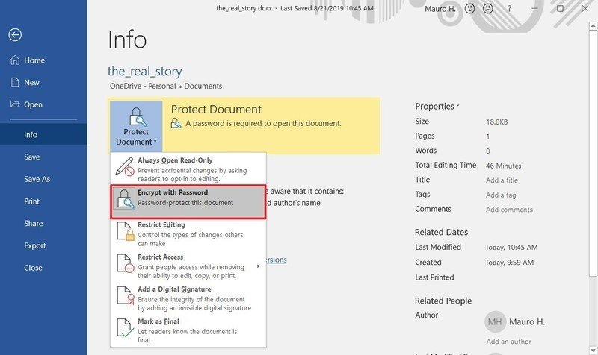
Continue..

Slide 14
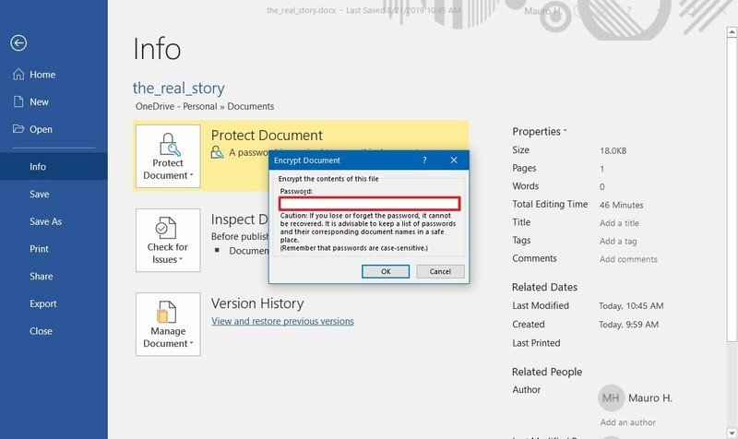
Clear the current password.

Slide 15
Continue..
Click the OK button.
After completing the steps, anyone without a password will be not able to open and edit the Office document.

Slide 16
Top 10 ways to secure Microsoft 365 for business plans
If you are a small or medium-size organization using one of Microsoft's business plans and your type of organization is targeted by cyber criminals and hackers, here are some ways to increase the security of your organization.

Slide 17
1: Set up multi-factor authentication
You enable or disable security defaults from the Properties pane for Azure Active Directory (Azure AD) in the Azure portal.
Sign in to the Microsoft 365 admin center with global admin credentials.
In the left nav choose Show All and under Admin centers, choose Azure Active Directory.
In the Azure Active Directory admin center choose Azure Active Directory > Properties.
At the bottom of the page, choose Manage Security defaults.
Choose Yes to enable security defaults or No to disable security defaults, and then choose Save.
After you set up multi-factor authentication for your organization, your users will be required to set up two-step verification on their devices.

Slide 18
2: Train your users
Microsoft recommends that your users take the actions described in this article: Protect your account and devices from hackers and malware. These actions include:
Using strong passwords
Protecting devices
Enabling security features on Windows 10 and Mac PCs

Slide 19
3: Use dedicated admin accounts
The administrative accounts you use to administer your Microsoft 365 environment include elevated privileges. These are valuable targets for hackers and cyber criminals. Use admin accounts only for administration. Admins should have a separate user account for regular, non-administrative use and only use their administrative account when necessary to complete a task associated with their job function. Additional recommendations:
Be sure admin accounts are also set up for multi-factor authentication.
Before using admin accounts, close out all unrelated browser sessions and apps, including personal email accounts.
After completing admin tasks, be sure to log out of the browser session.

Slide 20
4: Raise the level of protection against malware in mail
Your Microsoft 365 environment includes protection against malware, but you can increase this protection by blocking attachments with file types that are commonly used for malware. To bump up malware protection in email, complete the following steps:
Go to https://protection.office.com and sign in with your admin account credentials.
In the Security & Compliance Center, in the left navigation pane, under Threat management, choose Policy > Anti-Malware.
Double-click the default policy to edit this company-wide policy.
Select Settings.
Under Common Attachment Types Filter, select On. The file types that are blocked are listed in the window directly below this control. You can add or delete file types later, if needed.
Select Save.

Slide 21
5: Protect against ransomware
Ransomware restricts access to data by encrypting files or locking computer screens. It then attempts to extort money from victims by asking for "ransom," usually in form of cryptocurrencies like Bitcoin, in exchange for access to data.
You can protect against ransomware by creating one or more mail flow rules to block file extensions that are commonly used for ransomware, or to warn users who receive these attachments in email. A good starting point is to create two rules:
Warn users before opening Office file attachments that include macros. Ransomware can be hidden inside macros, so we'll warn users to not open these files from people they do not know.
Block file types that could contain ransomware or other malicious code.

Slide 22
Continue..
To create a mail transport rule, view a short training video, or complete the following steps:
Go to the Exchange admin center.
In the mail flow category, select rules.
Select +, and then Create a new rule.
Select **** at the bottom of the dialog box to see the full set of options.
Apply the settings in the following table for each rule. Leave the rest of the settings at the default, unless you want to change these.
Select Save.

Slide 23
6: Stop auto-forwarding for email
Hackers who gain access to a user's mailbox can exfiltrate mail by configuring the mailbox to automatically forward email. This can happen even without the user's awareness. You can prevent this from happening by configuring a mail flow rule. To create a mail transport rule:
Go to the Exchange admin center.
In the mail flow category, select rules.
Select +, and then Create a new rule.
Select More options at the bottom of the dialog box to see the full set of options.
Apply the settings in the following table. Leave the rest of the settings at the default, unless you want to change these.
Select Save.

Slide 24
7: Use Office Message Encryption
Office Message Encryption is included with Microsoft 365. It's already set up. With Office Message Encryption, your organization can send and receive encrypted email messages between people inside and outside your organization. Office 365 Message Encryption works with Outlook.com, Yahoo!, Gmail, and other email services. Email message encryption helps ensure that only intended recipients can view message content.
Office Message Encryption provides two protection options when sending mail:
Do not forward
Encrypt

Slide 25
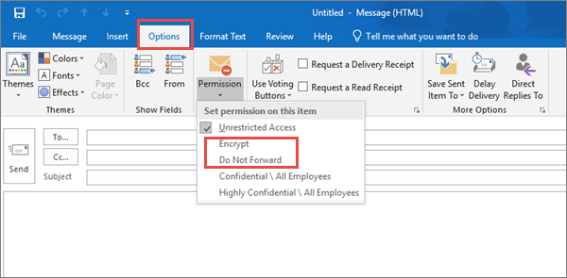
To send protected email
In Outlook for PC, select Options in the email, and then choose Permissions.

Slide 26
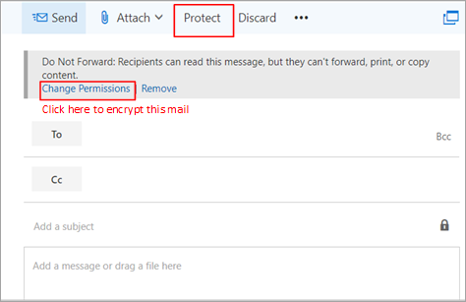
Continue..
In Outlook.com, select Protect in the email. The default protection is Do not forward. To change this to encrypt, select Change Permissions > Encrypt.

Slide 27
To receive encrypted email
If the recipient has Outlook 2013 or Outlook 2016 and a Microsoft email account, they'll see an alert about the item's restricted permissions in the Reading pane. After opening the message, the recipient can view the message just like any other.
If the recipient is using another email client or email account, such as Gmail or Yahoo, they'll see a link that lets them either sign in to read the email message or request a one-time passcode to view the message in a web browser. If users aren't receiving the email, have them check their Spam or Junk folder.

Slide 28
8. Protect your email from phishing attacks
If you've configured one or more custom domains for your Microsoft 365 environment, you can configure targeted anti-phishing protection. Anti-phishing protection, a part of Microsoft Defender for Office 365, can help protect your organization from malicious impersonation-based phishing attacks and other phishing attacks. If you haven't configured a custom domain, you do not need to do this.

Slide 29
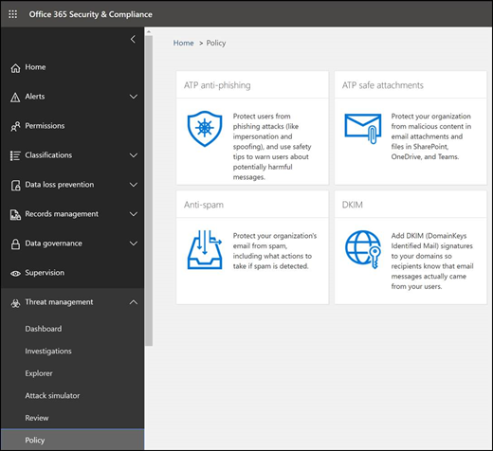
Continue..

Slide 30
Continue..
To create an anti-phishing policy in Defender for Office 365, view a short training video, or complete the following steps:
Go to https://protection.office.com.
In the Security & Compliance Center, in the left navigation pane, under Threat management, select Policy.
On the Policy page, select Anti-phishing.
On the Anti-phishing page, select + Create. A wizard launches that steps you through defining your anti-phishing policy.
Specify the name, description, and settings for your policy as recommended in the chart below. See Learn about anti-phishing policy in Microsoft Defender for Office 365 options for more details.
After you have reviewed your settings, select Create this policy or Save, as appropriate.

Slide 31
9: Protect against malicious attachments and files with Safe Attachments
People regularly send, receive, and share attachments, such as documents, presentations, spreadsheets, and more.
It's not always easy to tell whether an attachment is safe or malicious just by looking at an email message.
Microsoft Defender for Office 365 includes Safe Attachment protection, but this protection is not turned on by default. For that, create a new rule to begin using this protection. This protection extends to files in SharePoint, OneDrive, and Microsoft Teams.

Slide 32
Continue..
Go to https://protection.office.com and sign in with your admin account.
In the Security & Compliance Center, in the left navigation pane, under Threat management, select Policy.
On the Policy page, select Safe Attachments.
On the Safe attachments page, apply this protection broadly by selecting the Turn on ATP for SharePoint, OneDrive, and Microsoft Teams check box.
Select + to create a new policy.
Apply the settings in the following table.
After you have reviewed your settings, select Create this policy or Save, as appropriate.

Slide 33
10: Protect against phishing attacks with Safe Links
Hackers sometimes hide malicious websites in links in email or other files. Safe Links, part of Microsoft Defender for Office 365, can help protect your organization by providing time-of-click verification of web addresses (URLs) in email messages and Office documents. Protection is defined through Safe Links policies.
Modify the default policy to increase protection.
Add a new policy targeted to all recipients in your domain.

Slide 34
Continue..
To get to Safe Links, view a short training video, or complete the following steps:
Go to https://protection.office.com and sign in with your admin account.
In the Security & Compliance Center, in the left navigation pane, under Threat management, select Policy.
On the Policy page, select Safe Links.

Slide 35
Continue..
To modify the default policy:
On the Safe links page, under Policies that apply to the entire organization, double-click the Default policy.
Under Settings that apply to content across Office 365, enter a URL to be blocked, such as example.com, and select +.
Under Settings that apply to content except email, select Office 365 applications, Do not track when users click safe links, and Do not let users click through safe links to original URL.
Select Save.

Slide 36
How can you protect yourself against malicious code?
Install and maintain antivirus software. Antivirus software recognizes malware and protects your computer against it. Installing antivirus software from a reputable vendor is an important step in preventing and detecting infections. Always visit vendor sites directly rather than clicking on advertisements or email links. Because attackers are continually creating new viruses and other forms of malicious code, it is important to keep your antivirus software up-to-date.

Slide 37
Continue..
Use caution with links and attachments. Take appropriate precautions when using email and web browsers to reduce the risk of an infection. Be wary of unsolicited email attachments and use caution when clicking on email links, even if they seem to come from people you know.

Slide 38
Continue..
Block pop-up advertisements. Pop-up blockers disable windows that could potentially contain malicious code. Most browsers have a free feature that can be enabled to block pop-up advertisements.
Use an account with limited permissions. When navigating the web, it's a good security practice to use an account with limited permissions. If you do become infected, restricted permissions keep the malicious code from spreading and escalating to an administrative account.

Slide 39
Continue..
Disable external media AutoRun and AutoPlay features. Disabling AutoRun and AutoPlay features prevents external media infected with malicious code from automatically running on your computer.
Change your passwords. If you believe your computer is infected, change your passwords. This includes any passwords for websites that may have been cached in your web browser. Create and use strong passwords, making them difficult for attackers to guess.

Slide 40
Continue..
Keep software updated. Install software patches on your computer so attackers do not take advantage of known vulnerabilities. Consider enabling automatic updates, when available.
Back up data. Regularly back up your documents, photos, and important email messages to the cloud or to an external hard drive. In the event of an infection, your information will not be lost.

Slide 41
Continue..
Install or enable a firewall. Firewalls can prevent some types of infection by blocking malicious traffic before it enters your computer. Some operating systems include a firewall; if the operating system you are using includes one, enable it.
Use anti-spyware tools. Spyware is a common virus source, but you can minimize infections by using a program that identifies and removes spyware. Most antivirus software includes an anti-spyware option; ensure you enable it.

Slide 42
Continue..
Monitor accounts. Look for any unauthorized use of, or unusual activity on, your accounts—especially banking accounts. If you identify unauthorized or unusual activity, contact your account provider immediately.
Avoid using public Wi-Fi. Unsecured public Wi-Fi may allow an attacker to intercept your device’s network traffic and gain access to your personal information.

Slide 43
How do you recover if you become a victim of malicious code?
Using antivirus software is the best way to defend your computer against malicious code. If you think your computer is infected, run your antivirus software program.
Ideally, your antivirus program will identify any malicious code on your computer and quarantine them so they no longer affect your system. You should also consider these additional steps:

Slide 44
1. Minimize the damage
If you are at work and have access to an information technology (IT) department, contact them immediately. The sooner they can investigate and “clean” your computer, the less likely it is to cause additional damage to your computer—and other computers on the network. If you are on a home computer or laptop, disconnect your computer from the internet; this will prevent the attacker from accessing your system.

Slide 45
2. Remove the malicious code.
If you have antivirus software installed on your computer, update the software and perform a manual scan of your entire system.
If you do not have antivirus software, you can purchase it online or in a computer store. If the software cannot locate and remove the infection, you may need to reinstall your operating system, usually with a system restore disk.
Note that reinstalling or restoring the operating system typically erases all of your files and any additional software that you have installed on your computer. After reinstalling the operating system and any other software, install all of the appropriate patches to fix known vulnerabilities.

Slide 46
Examples of malicious code attacks
Emotet trojan
First appearing in 2014, the Emotet trojan evolved from its malware roots to become email spam laden with malicious code. The attackers use phishing tactics like urgent email subject lines (ex: "Payment Needed") to fool users into downloads.
Once on a device, Emotet has been known to run scripts that deliver viruses, install command and control (C&C) malware for botnet recruitment, and more. This threat took a short break in 2018 before returning to become an SMS malware threat in the process.

Slide 47
Continue..
Stuxnet worm
Since 2010, the Stuxnet computer worm and its successors have been targeting national infrastructure. Its first documented attack involved Iranian nuclear facilities via USB flash drive, destroying critical equipment. Stuxnet has since ceased, but its source code has been used to create similar highly targeted attacks through 2018.

Slide 48
Conclusion
Threats to your computer will continue to evolve. Although you cannot eliminate every hazard, by using caution, installing and using antivirus software, and following other simple security practices, you can significantly reduce your risk and strengthen your protection against malicious code.

Slide 49
Password-cracking Techniques Used by Hackers
You certainly will always need to change your password, and sometimes more urgently than you think, but mitigating against theft is a great way to stay on top of your account security.
You can always head to www.haveibeenpwned.com to check if you’re at risk, but simply thinking your password is secure enough to not be hacked into is a bad mindset to have.

Slide 50
Continue..
So, to help you understand just how hackers get your passwords – secure or otherwise – we’ve put together a list of the top ten password-cracking techniques used by hackers.
Some of the below methods are certainly outdated, but that doesn’t mean they aren’t still being used.

Slide 51
1. Phishing
There’s an easy way to hack, ask the user for his or her password.
A phishing email leads the unsuspecting reader to a spoofed log in page associated with whatever service it is the hacker wants to access, usually by requesting the user to put right some terrible problem with their security.
That page then skims their password and the hacker can go use it for their own purpose.

Slide 52

Continue..

Slide 53
2. Social Engineering
Social engineering takes the whole “ask the user” concept outside of the inbox that phishing tends to stick with and into the real world.
A favorite of the social engineer is to call an office posing as an IT security tech guy and simply ask for the network access password. You’d be amazed at how often this works. Some even have the necessary gonads to don a suit and name badge before walking into a business to ask the receptionist the same question face to face.
Time and again, it’s been shown that many businesses either don’t have good security in place or people are too friendly and trusting when they shouldn’t be, such as giving people access to sensitive locations because of a uniform or sob story.

Slide 54
3. Malware
Malware comes in many forms, such as a keylogger, also known as a screen scraper, which records everything you type or takes screenshots during a login process, and then forwards a copy of this file to hacker central.
Some malware will look for the existence of a web browser client password file and copy it, which, unless properly encrypted, will contain easily accessible saved passwords from the user’s browsing history.

Slide 55
4. Dictionary Attack
The dictionary attack uses a simple file containing words that can be found in a dictionary, hence its rather straightforward name. In other words, this attack uses exactly the kind of words that many people use as their password.
Cleverly grouping words together such as “letmein” or “superadministratorguy” will not prevent your password from being cracked this way – well, not for more than a few extra seconds.

Slide 56
Continue..

Slide 57
5. Rainbow Table Attack
Rainbow tables aren’t as colorful as their name may imply but, for a hacker, your password could well be at the end of it.
In the most straightforward way possible, you can boil a rainbow table down into a list of pre-computed hashes – the numerical value used when encrypting a password.
This table contains hashes of all possible password combinations for any given hashing algorithm.
Rainbow tables are attractive as it reduces the time needed to crack a password hash to simply just looking something up in a list.

Slide 58
Continue..
However, rainbow tables are huge, unwieldy things. They require serious computing power to run and a table becomes useless if the hash it’s trying to find has been “salted” by the addition of random characters to its password ahead of hashing the algorithm.
There is talk of salted rainbow tables existing, but these would be so large as to be difficult to use in practice. They would likely only work with a predefined “random character” set and password strings below 12 characters as the size of the table would be prohibitive to even state-level hackers otherwise.

Slide 59
6. Spidering
Savvy hackers have realized that many corporate passwords are made up of words that are connected to the business itself. Studying corporate literature, website sales material, and even the websites of competitors and listed customers can provide the ammunition to build a custom word list to use in a brute force attack.
Really savvy hackers have automated the process and let a spidering application, similar to the web crawlers employed by leading search engines to identify keywords, and then collect and collate the lists for them.

Slide 60
7. Offline Cracking
It’s easy to imagine that passwords are safe when the systems they protect lock out users after three or four wrong guesses, blocking automated guessing applications.
Well, that would be true if it were not for the fact that most password hacking takes place offline, using a set of hashes in a password file that has been ‘obtained’ from a compromised system.

Slide 61
Continue..
Often the target in question has been compromised via a hack on a third party, which then provides access to the system servers and those all-important user password hash files.
The password cracker can then take as long as they need to try and crack the code without alerting the target system or individual user.

Slide 62
8. Brute Force Attack
Similar to the dictionary attack, the brute force attack comes with an added bonus for the hacker. Instead of simply using words, a brute force attack lets them detect non-dictionary words by working through all possible alpha-numeric combinations from aaa1 to zzz10.
It’s not quick, provided your password is over a handful of characters long, but it will uncover your password eventually. Brute force attacks can be shortened by throwing additional computing horsepower, in terms of both processing power – including harnessing the power of your video card GPU – and machine numbers, such as using distributed computing models like online bitcoin miners.

Slide 63

Continue..

Slide 64
9. Shoulder Surfing
Another form of social engineering, shoulder surfing, just as it implies, entails peeking over a person’s shoulders while they’re entering credentials, passwords, etc.
Although the concept is very low tech, you’d be surprised how many passwords and sensitive information is stolen this way, so remain aware of your surroundings when accessing bank accounts, etc. on the go.

Slide 65
Continue..
The most confident of hackers will take the guise of a parcel courier, aircon service technician, or anything else that gets them access to an office building.
Once they are in, the service personnel “uniform” provides a kind of free pass to wander around unhindered, and make note of passwords being entered by genuine members of staff.
It also provides an excellent opportunity to eyeball all those post-it notes stuck to the front of LCD screens with logins scribbled upon them.

Slide 66

Continue..

Slide 67
10. Guess
The password crackers’ best friend, of course, is the predictability of the user. Unless a truly random password has been created using software dedicated to the task, a user-generated ‘random’ password is unlikely to be anything of the sort.
Instead, thanks to our brains’ emotional attachment to things we like, the chances are those random passwords are based upon our interests, hobbies, pets, family, and so on.

Slide 68
Continue..
In fact, passwords tend to be based on all the things we like to chat about on social networks and even include in our profiles.
Password crackers are very likely to look at this information and make a few – often correct – educated guesses when attempting to crack a consumer-level password without resorting to dictionary or brute force attacks.

Slide 69
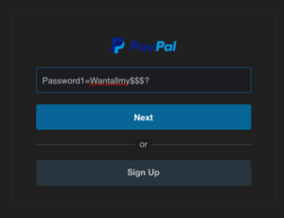
Continue..

Slide 70
Best Practices to Protect Yourself from Hackers
Maintain strong and unique passwords for all of your accounts, there are password managers available.
Don’t click on links or download files in emails arbitrarily, it’s best to not do it at all but activation emails prevent this.
Check for and apply security updates periodically. Most work computers might not allow this, the system administrator will take care of these things.

Slide 71
Continue..
When using a new computer or drive, consider using encryption. You can encrypt a HDD/SSD with data on it, but it can take hours or days because of the extra information.
Use the notion of least privilege, which means only give access to what’s needed. Basically, create user accounts that aren’t admins for casual computer use by you or friends and family.

Slide 72
To remove a computer virus and other malicious software
1. Install the latest updates from Microsoft Update
Note A computer virus may prevent you from accessing the Microsoft Update website to install the latest updates. It is recommended that you set the Automatic Updates service to run automatically so that a computer is not missing any important updates.
2. Use the free Microsoft Safety Scanner
Microsoft offers a free online tool that scans and helps remove potential threats from your computer. To perform the scan, go to the Microsoft Safety Scanner website.

Slide 73
3. Manually remove the rogue security software
Note the name of the rogue security software. For this example, we'll call it XP Security Agent 2010.
Restart your computer.
When you see the computer's manufacturer's logo, repeatedly press the F8 key.
When you are prompted, use the arrow keys to highlight Safe Mode with Networking, and then press Enter.
Click the Start button and check whether the rogue security software appears on the Start menu. If it's not listed there, click All Programs and scroll to find the rogue security software's name.
Right-click the name of the rogue security software program, and then click Properties.
Click the Shortcut tab.
In the Properties dialog box, check the path of the rogue security software program that is listed in Target. For example, C:\Program Files\XP Security Agent 2010.

Slide 74
Continue..
Note The folder name frequently is a random number.
Click Open File Location.
In the Program Files window, click Program Files in the address bar.
Scroll until you find the rogue security software program folder. For example, XP Security Agent 2010.
Right-click the folder, and then click Delete.
Restart your computer.
Go to the Microsoft Safety Scanner website.
Click the Download Now button, and then click Run.
Follow the instructions to scan your computer and help remove the rogue security software.
If you suspect that your computer is infected with rogue security software that was not detected by using Microsoft security solutions, you can submit samples by using the Microsoft Malware Protection Center submission form.

Slide 75
4. Run Microsoft Defender Offline
Microsoft Defender Offline is an anti-malware tool that helps remove difficult to eliminate viruses that start before Windows starts. Starting with Windows 10, Microsoft Defender Offline is built-in. To use it follow the steps in this article: Help protect my PC with Microsoft Defender Offline.

Slide 76
How to protect your computer against malware
Turn on the firewall: Confirm that the Windows firewall is turned on.
Install antivirus software: If you want to avoid getting a virus on your devices from the internet, installing and running antivirus software is important. Cyberthreats have evolved, and everyday activities like online banking, shopping, and browsing can make you vulnerable to cyberthreats.
Viruses are a major cyberthreat, which is why it’s smart to keep your devices protected against them. Reputable security software can help protect against phishing and other online threats as you bank, shop, and browse online.

Slide 77
Continue..
Be careful with email attachments: Email services like Gmail and Outlook ask for your permission before downloading an attachment. There’s a reason for that. Downloading an attachment can be dangerous. While email services often have virus protection built into their software, emails with viruses as attachments can still reach your inbox.
Cybercriminals often try to spread a virus with spamming emails. They send the emails with malicious attachments to a multitude of people. Once opened and executed, the virus can install in the background and begin its work.

Slide 78
Continue..
If you don’t know the person who sent you an email attachment — or if the email looks like it could be a phishing attempt — then ignoring it might be your best option. Only click on attachments or download files from your email if you trust the source.
It’s also smart to disable image previews within your email software. This feature can be found in the Options or Settings of the program.
Some viruses can attach to images and install themselves as soon as the email is opened. You can configure your settings to only show images from trusted sources. This can help prevent an infected image from turning into a virus on your computer.

Slide 79
Continue..
Patch your operating system and applications
Tech companies routinely put out software updates to make their devices or software safer to use. Without these updates, cybercriminals can abuse security flaws and force a device to download a virus.
This cyberthreat is called a software vulnerability. You might be careful to avoid viruses on the internet, but a software vulnerability may lurk in the background of your computer. The only way to ensure you’ve covered this risk? Regularly update your software whenever a patch is available. Or you can adjust your computer settings to accept updates automatically.

Slide 80
Continue..
Avoid questionable websites
It is believed that there are over 1.7 billion websites in the world, and not all of them have the best intentions. The bad ones that pose a cyberthreat will use a variety of tools to download a virus to your computer, like drive-by downloads, hosting malicious advertisements, and getting you to click on misleading links.
Avoid clicking on links to websites with suspicious names, such as mixtures of letters and numbers that don’t resemble words. Also be on the lookout for websites that share names of trusted brands, but have a variation within the URL. If there are extra symbols in the URL, it’s likely a fake website.

Slide 81
Continue..
Avoid pirated software: It might be tempting to get a free copy of a game, movie, or application that everyone else has to pay for. But if you download a cracked or illegal version of software, your computer or mobile device could be at risk.
Pirated software often comes from difficult-to-find websites or peer-to-peer sharing, both of which contain users who may simply be looking for their favorite movie, or those who are looking to spread a virus.

Slide 82
Continue..
With no virus protection built into what’s being downloaded, it’s easy for a cybercriminal to slip a virus into a free application. Sometimes there won’t even be any free software — just a virus.
Be cautious when downloading anything for free. If you download pirated files — which is not recommended — make sure you’re using antivirus software.

Slide 83
Continue..
Backup your computer
This tip may not help you avoid getting a virus on your devices from the internet, but it will help you sidestep some of the damage and stress that comes with it if you do.
By regularly using a cloud backup, you can keep copies of all your important files and records in a location that won’t be contaminated by the virus.
Then, should you become a victim of a computer virus that’s difficult to get rid of without damaging your files, you can simply wipe your device and restore it to the most recent point before it was infected.

